Slide 1
Implementing “request a copy” button for etheses at Birmingham
From 2,500 per annum
to 250,000 per annum
Notes:
Keen to improve access to theses.
Theses notoriously difficult to get hold off.
Handled 1 per working week from stock of 36,000.

Slide 2
Etheses options
A. Fully open access (Recommended)
B. Electronic copy restricted, full copies may be provided on request
Request a copy button added
On EThOS if requested?
C. Electronic copy restricted, no full copies to be made
Request a copy button added
Not on EThOS
D. Embargo on access to any copy
No full text ‘though redacted abstract available

Slide 3
88% on Open Access

Slide 4
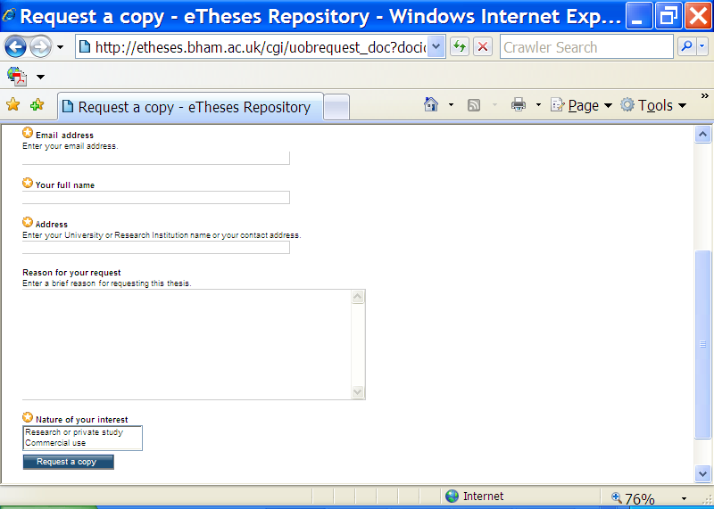

Slide 5
Request a copy – MINI ETHOS?
407 requests since Jan 2010
1 per working day/8 per week
147 option Bs (36%) and 260 (64%) option Cs
Top three items make up 1/8th of requests with long tail
110 unique titles requested (7% of ecopies)
Often requested a few days after release suggesting google alerts
(compares with one per week pre-mandate and pre EThOS)
Notes:
Would send 200 theses per annum via ILLs (figure in 2005) for the UK. 100 photocopy requests for overseas. Could not fill most requests as we sought permission from authors. We make an attempt to contact all authors. Now we take “risk managed approach” to covering ethos. We joined microfilm service from the BL in 2000.
Store fetching : 2002/2003 we supplied 2179 theses to people coming in to consult theses.

Slide 6
What has gone well
Fulfilling requests using “risk managed approach”
Increase in BU theses available including older theses
Increase in access points to BU theses
Made available to Ethos for harvesting
Exposed to repository and bibliographic search tools via OAI-PMH including index to theses and DART
Dialogue with authors on copyright and data protection before requests are forwarded for action including instructions on how to deal with requests

Slide 7
Notes:
Top eight items make up 1/8th of requests with long tail

Slide 8
On going challenges
To add more etheses more quickly and more efficiently
Time consuming to check each thesis for copyrighted/sensitive material to enable them to be deposited
Keeping contact details/requests up to date esp when no response from authors
Identifying older theses for digitisation
Etheses.bham.ac.uk
Notes:
2007 1848
2008 1820
2009 1748
2010 1729
2011 1370
Digitised by ethos (older theses proving requestors want newist research)
2009 453
2010 314
2011 188

